Slide 1
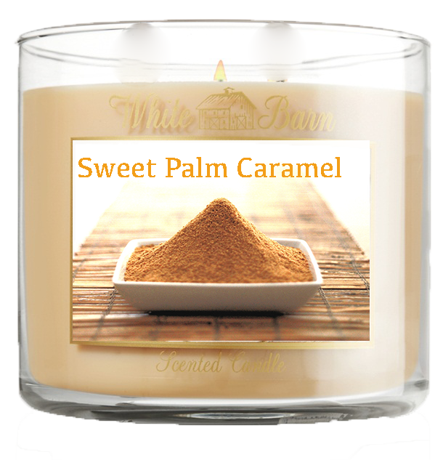
Sugar Candle
By: Michelle, Edson, Noxx, Alex, Jason, Jack

Slide 2
About Our Company
Masarang Sugar Candles
Contact Info:
E-mail Twitter
Youtube Phone Line (Customer Service and office)
Facebook
Additional website link in Masarang Official Cite
“To promote public awareness of the Masarang organization through our products and further support Masarang”

Slide 3
Product
8oz Per Candle
$11 Usd per candle
Burning Time : 64 – 72 hours
70% Wax
30% Masarang Palm Sugar

Slide 4
Materials (Operations)
Classic Tumbler Jar
White Tumbler box
Paraffin Wax
Masarang Sugar
Pre Tabbed Candle Wick
-Refer to the operations plan and the finance report for exact material quantity and cost

Slide 5
Production
Product made in Indonesia alongside the sugar factory then shipped to Hong Kong and distributed locally
Producing 10 candles per hour , 1320 candles per month, -5% will be used as samples and quality testing
Working hours:
Office – 8 hours on weekdays, 6 hours on Saturday
Factory – 6 hours per day
We will ship our product from Indonesia once in 2 months time

Slide 6
Target
Currently only offers to sell in Hong Kong since:
Close to Indonesia (cheaper logistics)
The 8th most richest country (according to The Forbes)
Knowledge about Masarang
Resellers:
Hotels Restaurant
Supermarket Wedding Planners/Party Stores
Furniture Stores

Slide 7
Audience
Mainly female, since:
Manufacturer surveys prove that 90% of all candles are purchased by women (according to the National Candle Association)

Slide 8
Advertisement
Posting Ads on:
Facebook
Youtube (In-Stream)
Videos
Flyers
Samples

Slide 9
Human Resources
Office located in Hong Kong
Factory located in Indonesia
Staff:
1 CEO
4 Managers
3 Sales
10 other office workers
35 Factory workers

Slide 10
Advantages
Different from others.
Production will not be easily affected by other factors
Perfect for winter and a great Christmas present. Statistic shows that 35% of candles are sold during the Christmas season (according to The National Candle Association)

Slide 11
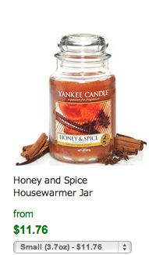
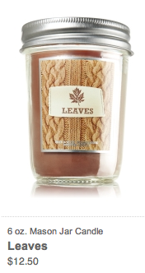
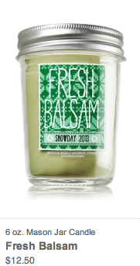
Competitors

Slide 12
Finance (USD)
Marketing Cost – $695.65
Material Cost – $1148.4
Logistic Cost – $627.55
Rent Cost – $193.49
Electricity Cost – $11.55
Wages – $45301.2

Slide 13
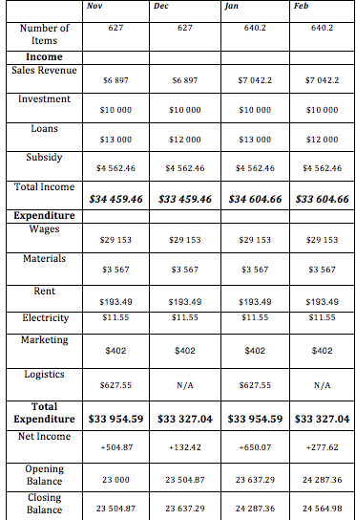
Finance

Slide 14
Finance
Apply for government SME development fund (supports in marketing and production cost)

Slide 15
Company’s Closing Balance For 4 Months

Slide 16
Future Plans
Create and develop other scents like Palm Tree, Rainforest, etc.
Expand our product to a worldwide level, starting with Asia.
Dividing candle scent to different levels , from mild to intense.
Cooperate with internet resellers including but not limited to : Amazon and EBay

Slide 17
Source Of Supporting Statistic
http://www.candles.org/about_facts.html
http://www.forbes.com/pictures/egim45egde/8-hong-kong/
http://www.nittanyvalleyorganics.com/candleburningtimes.html

Slide 18
End
Thank You

