Slide 1
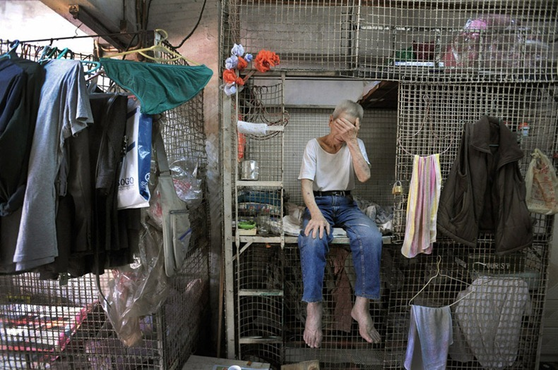
Put yourself in the picture:
What might he be thinking about?
Is this man happy? Why?
What does this place smell like?
Is this a quiet or a noisy place?
Is it hot or cold here?
What other questions could you ask to put yourself in the picture?

